Slide 1
Big Dataproject Covid-19 Analysis
Big Data
A Complete pipeline and analysis

Slide 2
Overview
Ingestion
Storage
Analysis
Visualization
Conclusion

Slide 3
Data ingestion
Data Storage
Use Winscp to transfer data from win to linux
Load
Create directories of data to trigger in data storage.
Create
Use the LOAD_TO_HDFS shell script to put it in distributed
Use

Slide 4
Data Analysis
We will use at the analysis phase hive to query the data :
1- create database and save the data.
2- create staging table to hold the data
3- create partition table to hold the data into partition to be easy to query
4- create output table to hold the output data .
5- load the top countries in deaths and tests into output table.
6- save into csv file into local linux.
7- delete the database.(update)

Slide 5
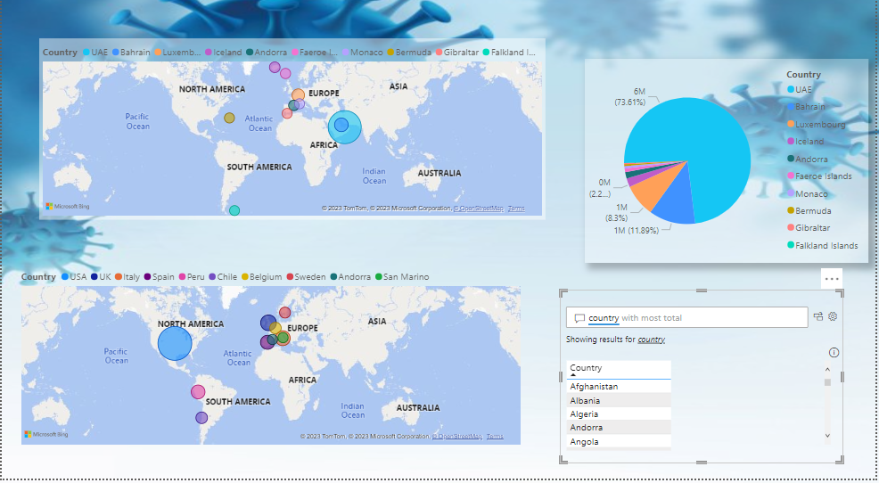
Data Visulization
We will use power bi to dashboard the data output
App ver

Slide 6
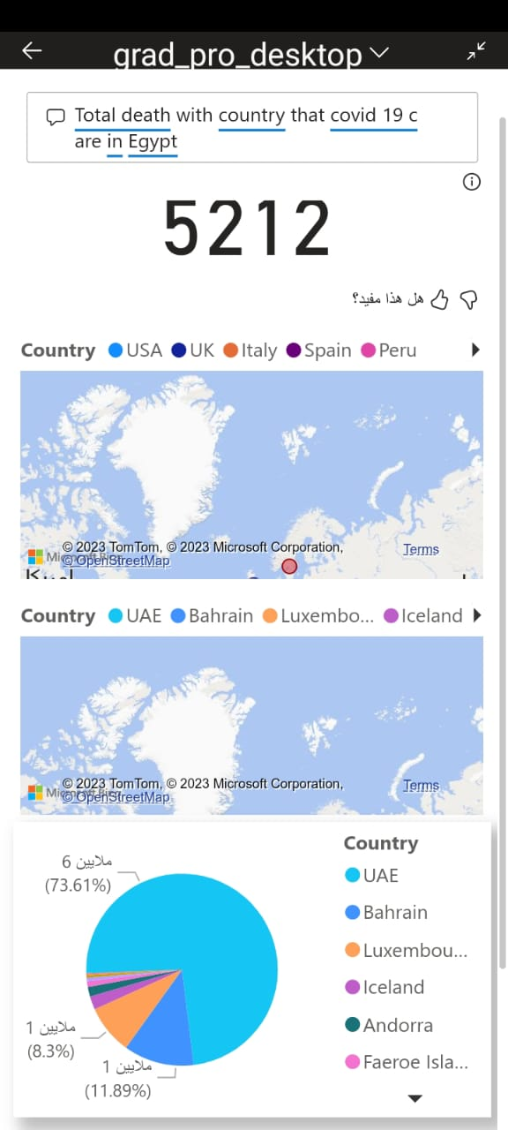
Mobile Ver

Slide 7
Conclusion
1- we can say uae has better treatment as the number of tests is the hightest but it’s not also accurate it has small population it may has good treatment but i can’t say best .
2- we can say that usa has the most bad treatment system as it has the most number of deaths but we can’t say that as it has over 200 million of people , yes it may have too much deaths but we can’t also be accurate it that.
3- data need to be more augmented
4- dashboard need to relate more variables to each other to have more judgement in your insights.

Slide 8
Thank you
Github : https://github.com/NeTrOn404/Big-data-Masteclass
Linkedin : https://www.linkedin.com/in/ebrahim-rabea-b01a68215/

